Slide 1
Pizza Hut Sales Analysis Using MYSQL! 🍕📊

Slide 2
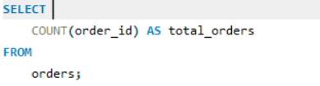
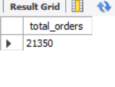
- RETERIVE THE TOTAL NUMBER OF ORDERS SALES

Slide 3
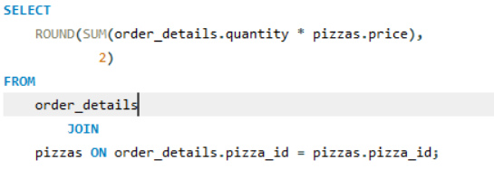
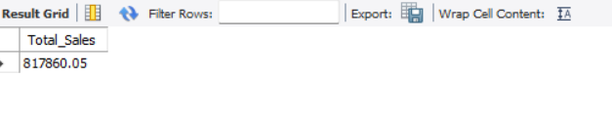
-- CALCULATE THE TOTAL REVENUE GENRATED FROM PIZZA SALES

Slide 4
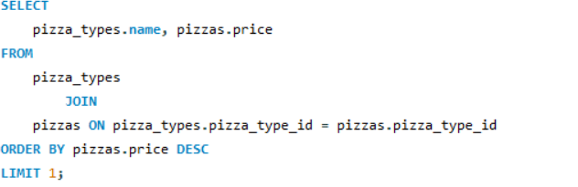
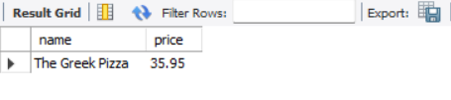
IDENTIFY THE HIGHEST PRIZED PIZZA

Slide 5
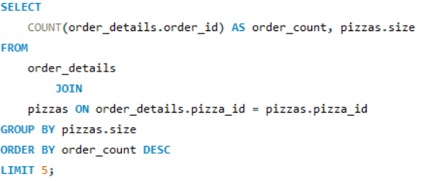
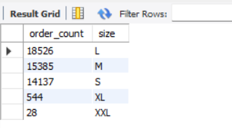
-- IDENTIFY THE MOST COMMON PIZZA SIZE ORDERED

Slide 6
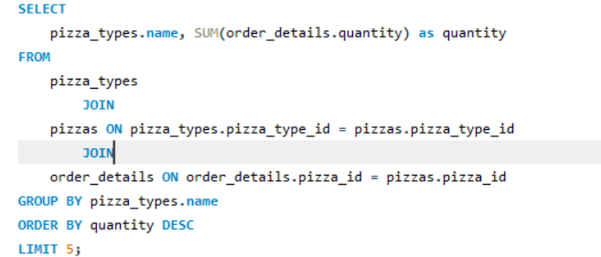
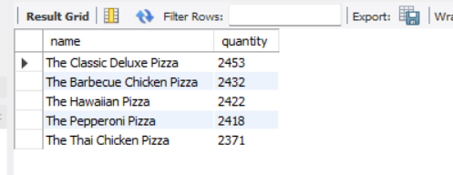
LIST TOP 5 MOST ORDERED PIZZA TYPES ALONG WITH THEIR QUANTITIES

Slide 7
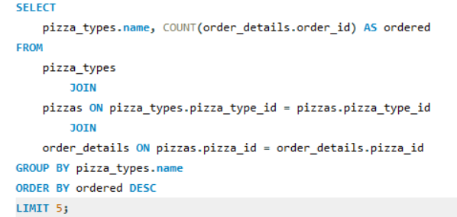
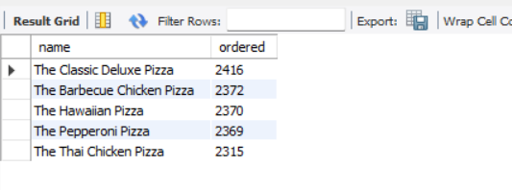
JOIN THE NECESSARY TABLES TO FIND THE TOTAL QUANTITY OF EACH PIZZAS ORDERDED

Slide 8
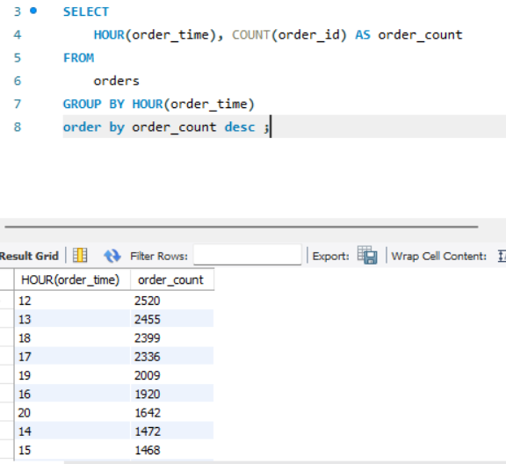
DETERMINE THE DISTRIBUTION OF ORDERS BY HOUR OF DAY

Slide 9
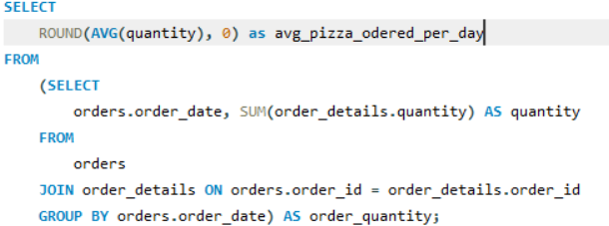
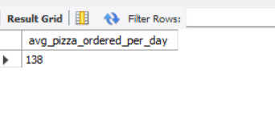
GROUP THE ORDERS BY DATE AND CALCULATE THE AVERAGE NUMBER OF PIZZAS ORDERED PER DAY

Slide 10
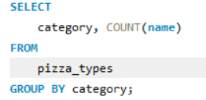
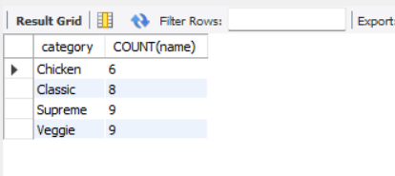
JOIN RELEVENT TABLE TO FIND THE CATEGORY WISE DISTRIBUTION OF PIZZAS

Slide 11
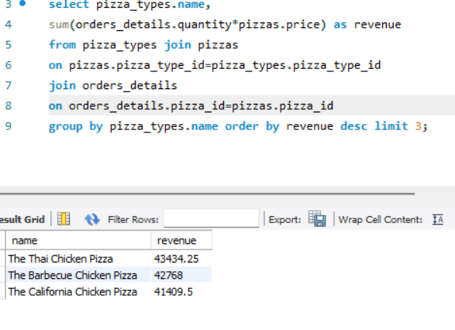
DETERMINE TOP 3 MOST ORDERED PIZZAS TYPES BASED ON REVENUE

Slide 12
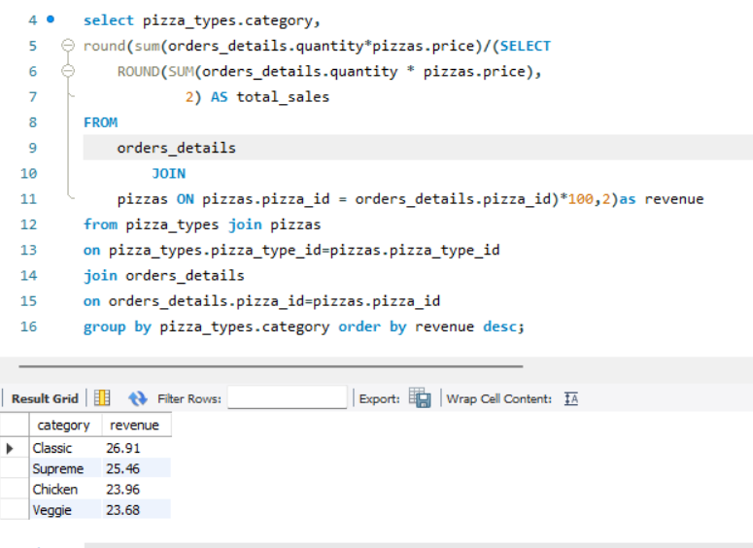
DETERMINE PERCENTAGE CONTRIBUTION OF EACH PIZZAS TYPE OF TOTAL REVENUE

Slide 13
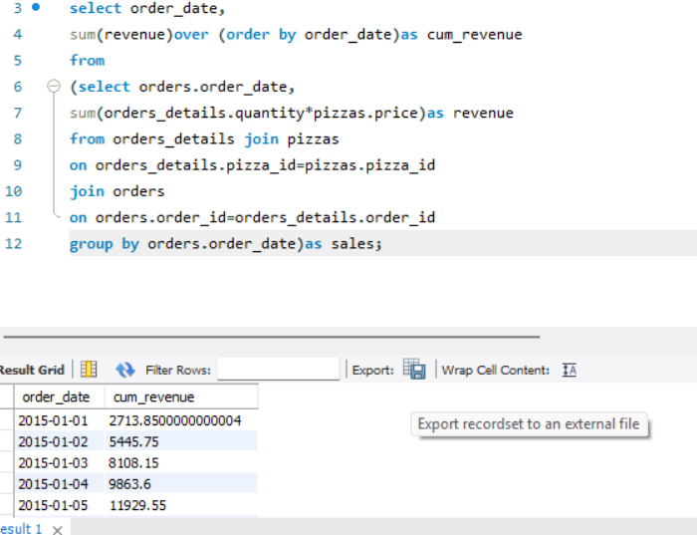
ANALIYZE THE CUMULATIVE REVENUE GENRATED OVER TIME

Slide 14
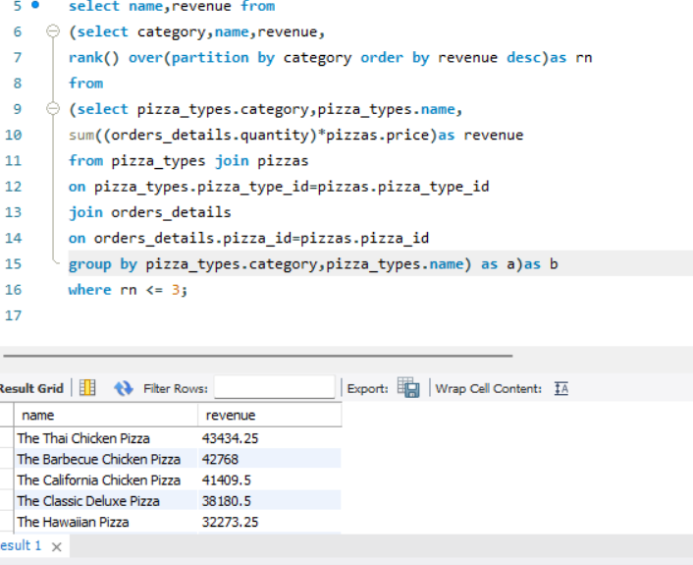
DETERMINE THE TOP 3 MOST ORDERED PIZZA TYPES BASED ON REVENUEFOR EACH PIZZA CATEGORY

